Slide 1
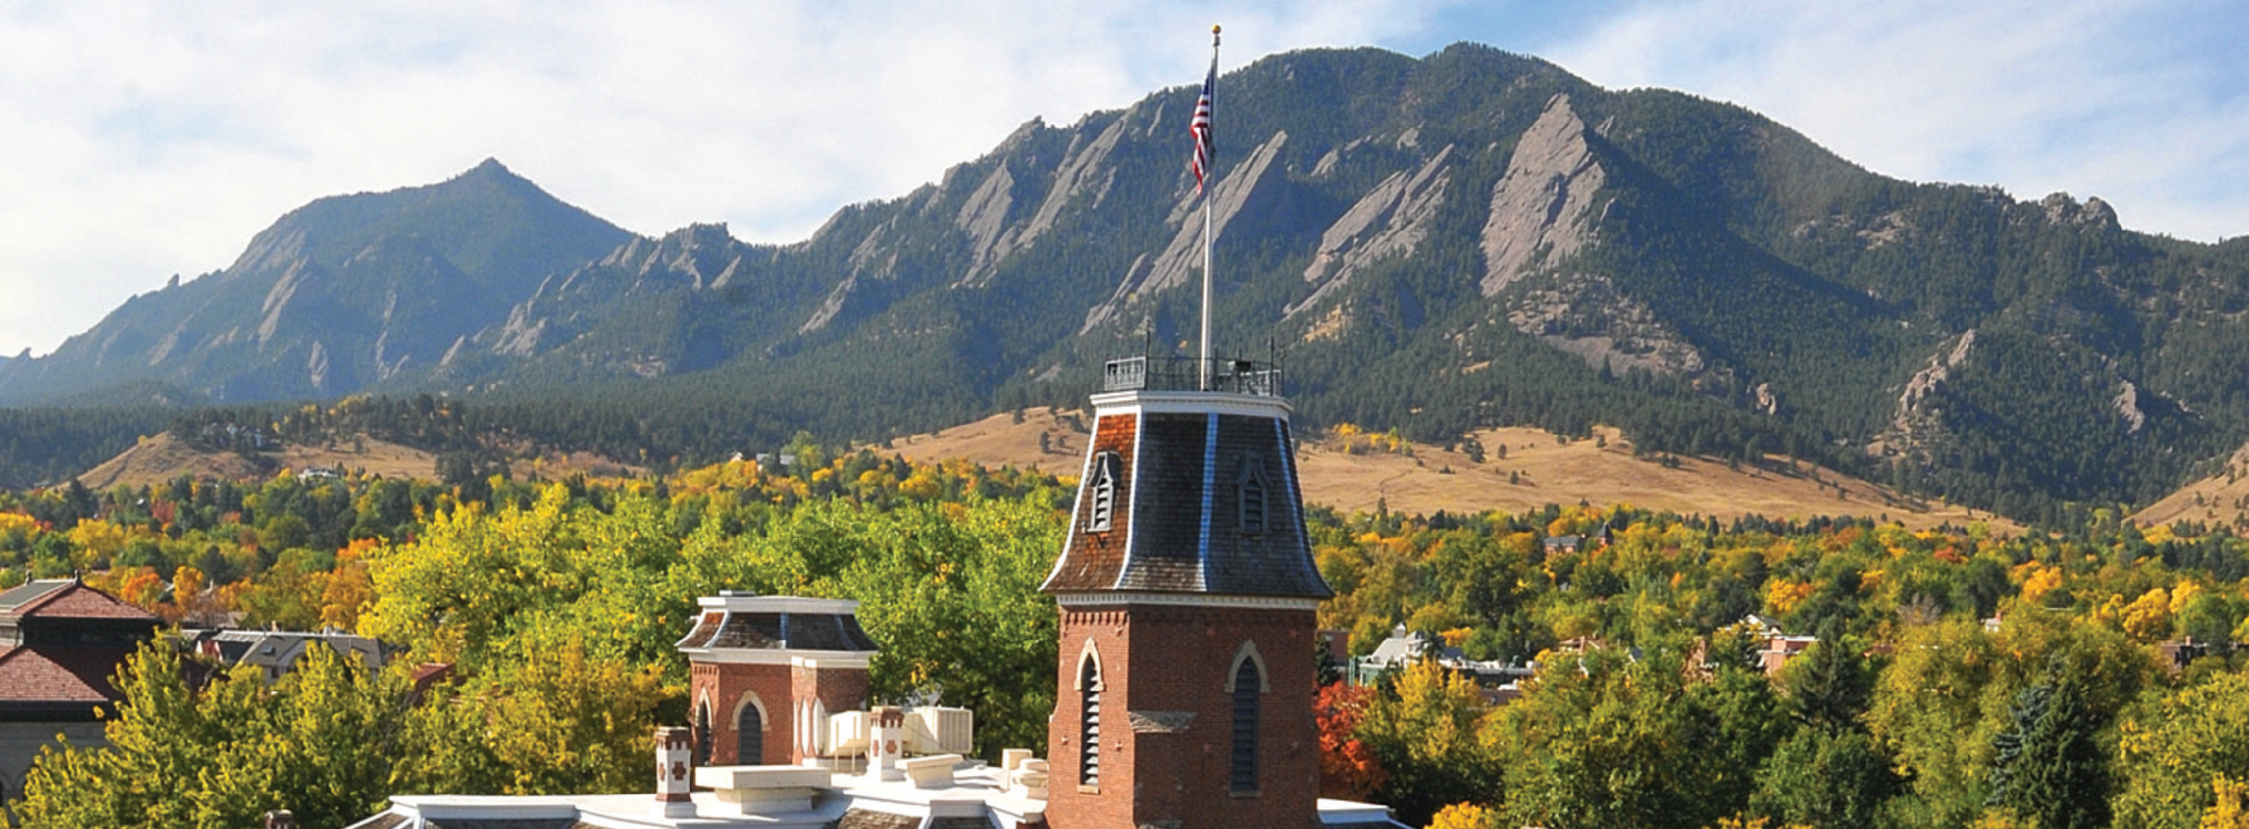
Research Computing in the Cloud: CU Research Computing Cloud Foundations Service

Slide 2
Research Computing in the Cloud
Andrew Wilson (CU Boulder Research Computing User Support)
www.rc.colorado.edu
rc-help@colorado.edu

Slide 3
Outline
Introduction to AWS
What is it?
Considerations
What services do they offer?
What specific tools are valuable in a research setting?
How to get started
Learning Materials

Slide 4
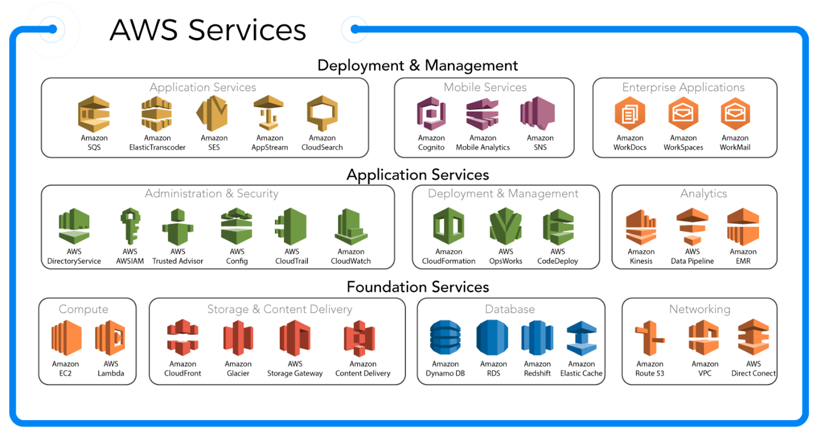
What is AWS?
Notes:
Amazon Web Services - (Host of cloud services)
A way to host your application or data on Amazon’s hardware

Slide 5

What scares you about working in the cloud?

Slide 6
Considerations
High Availability
Data Security
99.999999999% (11 9's) of data durability
Quick and easy Scalability
Getting closer to the data
Wide array of Computing Power
Cost Variability
Alleviate operational burden
Notes:
Don’t have to manage infrastructure
High availability
Go into availability zones?
Data security
Go into the .9999% thing from AWS
Quick and easy Scalability
Getting closer to the data
NASA data sets in cloud
Running applications in the geographical zone that the data is in
Choice of computing power
High memory
High CPU
GPU
High speed storage
HCP, HTC
Pretty much anything you want
Cost Variablility
Can be cheaper than running on-premise in many cases due to not having to pay for staffing, utilities, etc.
We've found it can be cheaper in comparison to an on-premise system that is not fully utilized

Slide 7
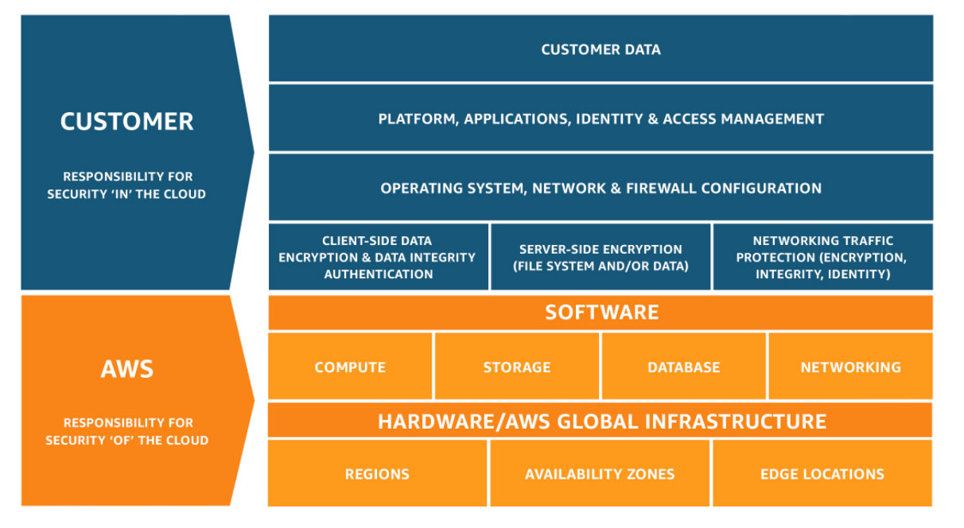
What are you responsible for?
Notes:
AWS removes the need to manage a datacenter

Slide 8
What tools are available?
Conventional Cloud Computing Resources
Virtual Machines (EC2)
Storage (S3)
Databases (RDS or Dynamo)
Quick Start Tools
Lightsail for Research

Slide 9
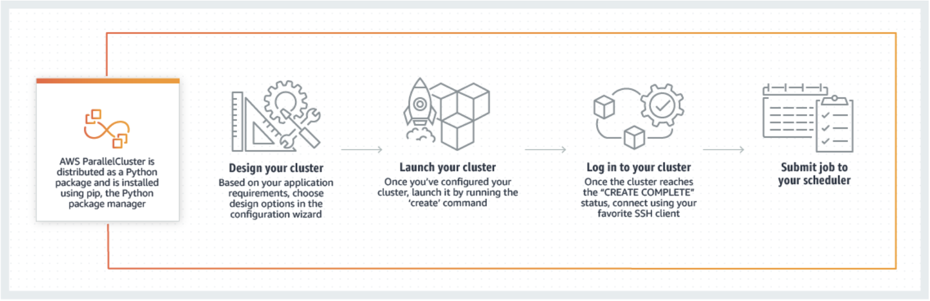
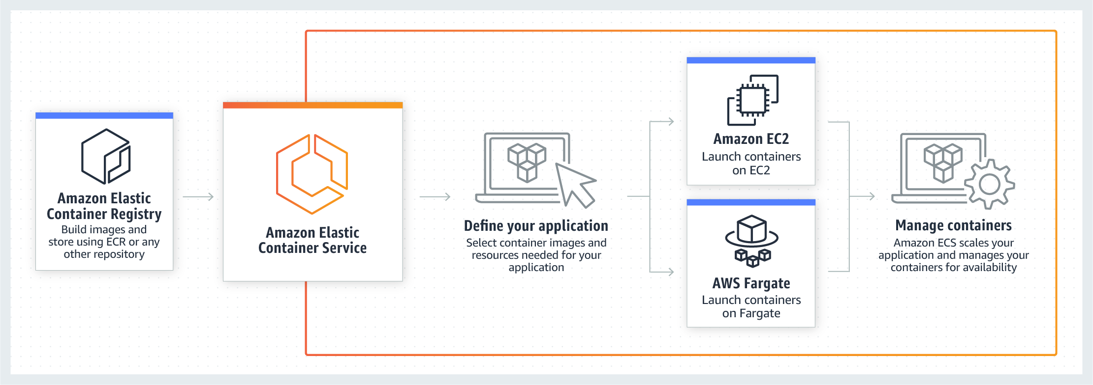
What tools are available?
Parallel Cluster
Advanced tools
Cluster Environments
Parallel cluster
Container Services
EKS, ECS
ECS

Slide 10
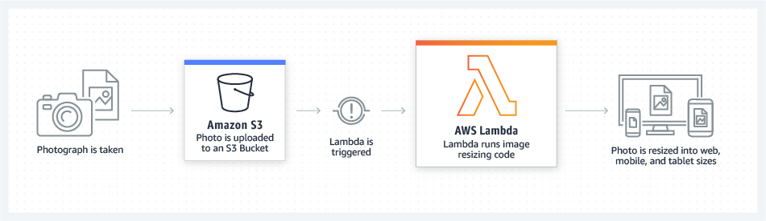
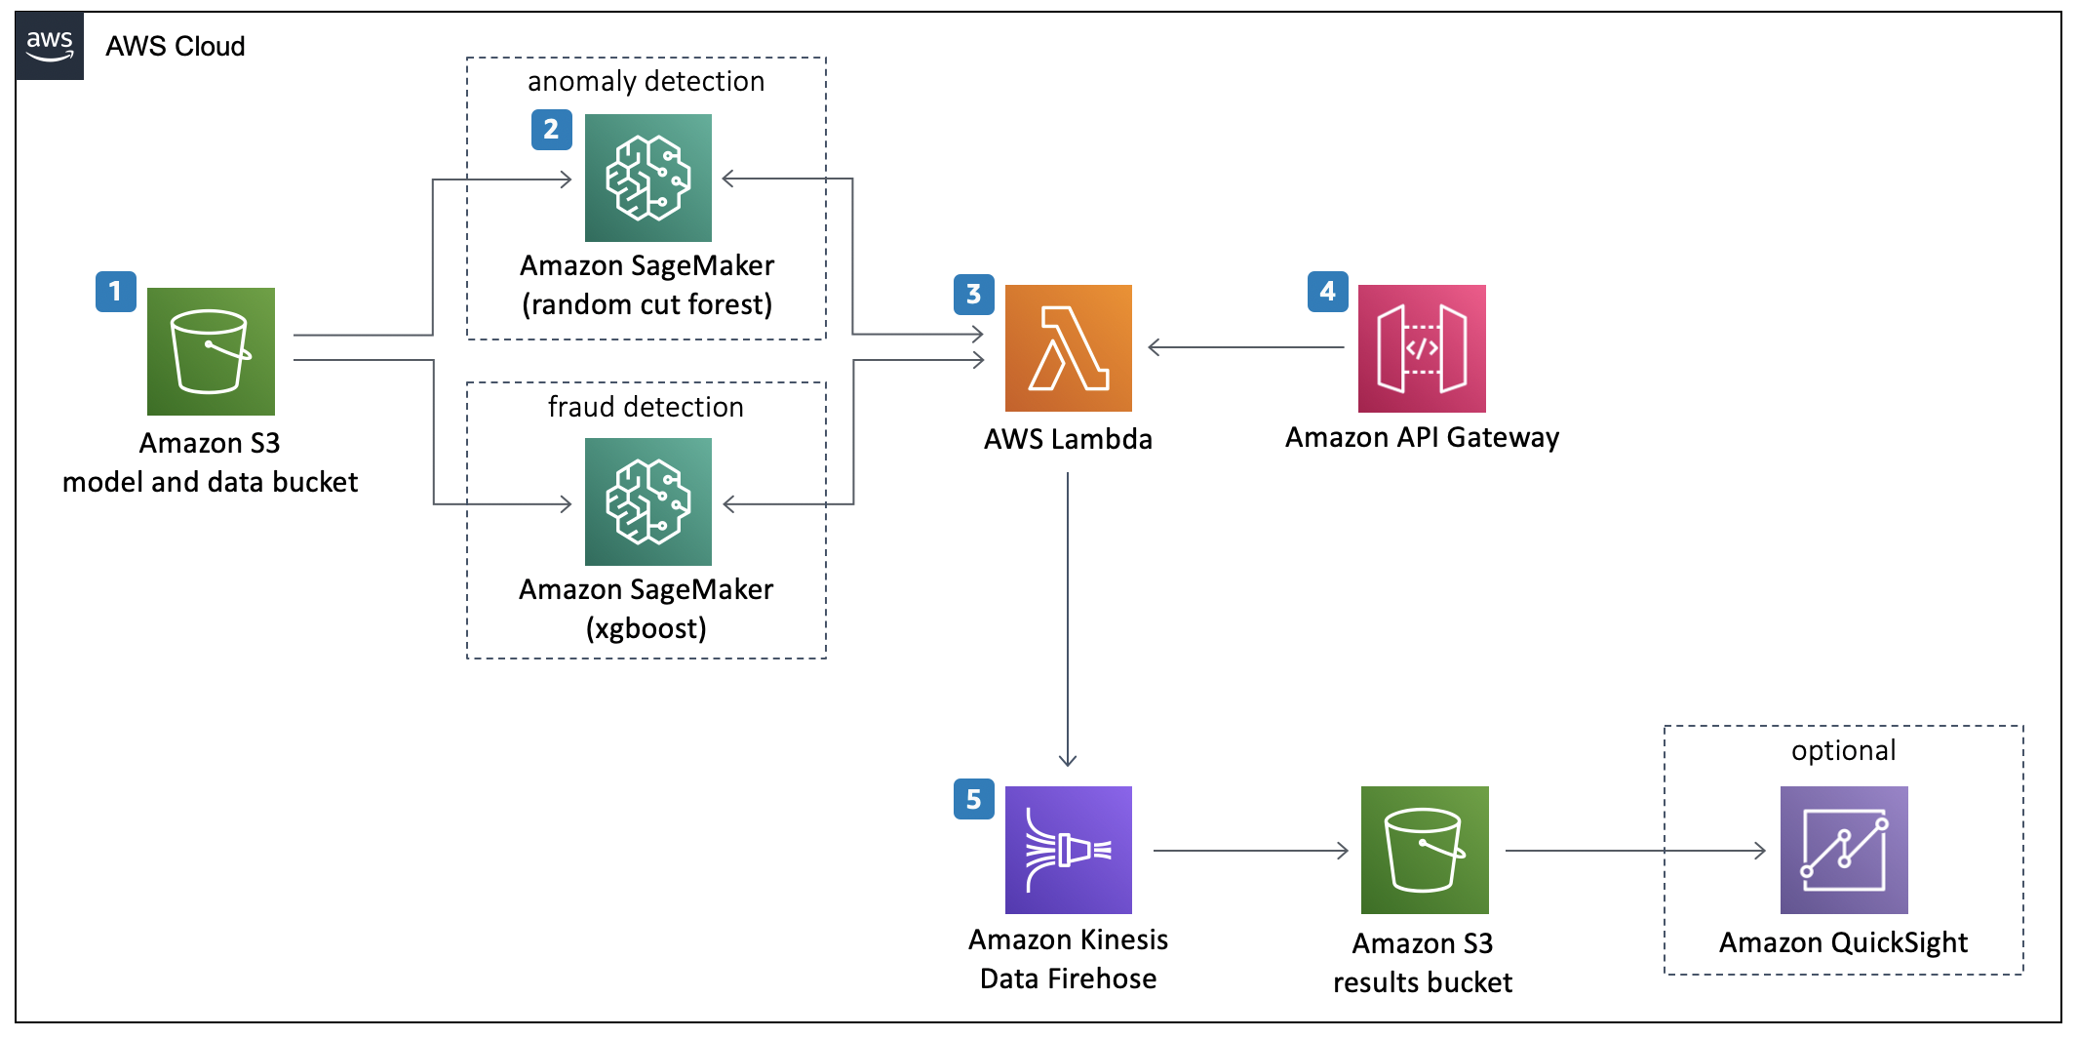
What tools are available?
Lambda
Advanced tools
Serverless code execution
Lambda
FPGA's
Machine Learning
Sagemaker, Rekognition, Polly, etc.
Sagemaker
Notes:
Lambda: Lambda natively supports Java, Go, PowerShell, Node.js, C#, Python, and Ruby code, and provides a Runtime API allowing you to use any additional programming languages to author your functions.

Slide 11
DEMO of Lightsail
http://bit.ly/OIT-AWS

Slide 12
How to get started
Reach out to the Cloud Foundations Service at CU
rc-help@colorado.edu
Provide access to centrally provisioned public cloud services for administrative, teaching & learning, and research needs. This includes new and existing applications, big data workloads and other workloads well suited to the major public cloud services.
What info is required?
Your project details
Notes:
We'll help to provision the resources you need, estimate costs for these resources.
We'll work with you on budgeting.

Slide 13
How to get started
What we Offer
Basic Security Guardrails
Billing against CU funds (Purchase Order)
Connection to internal CU resources
Federated Access
Support & Consulting
Notes:
Can communicate within the internal CU network
Federated Access (identikey)
Billing
Security, etc

Slide 14
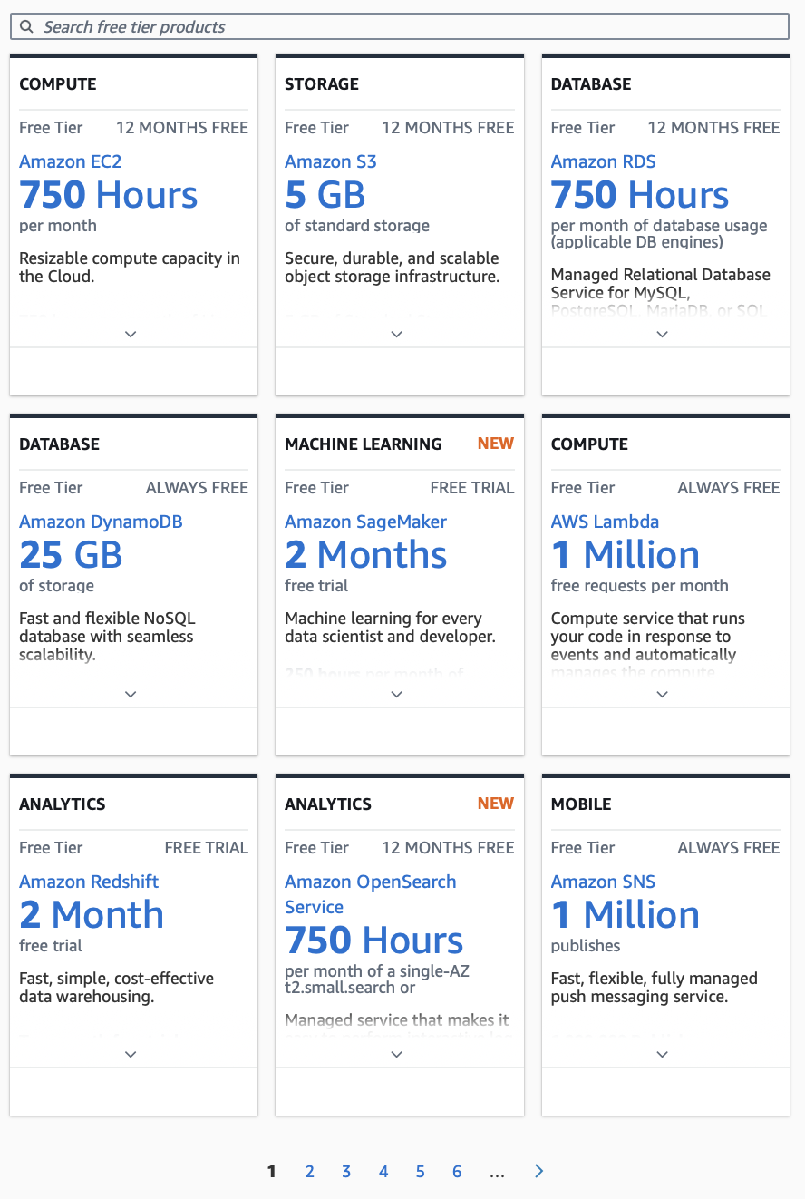
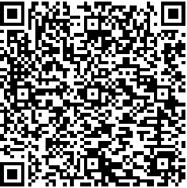
How to get started
Free Trials offered by AWS
AWS Free Tier

Slide 15
Learning Materials
Countless sites with training tools
acloudguru.com
AWS Events on Campus
Link to get notified
AWS Educate
https://aws.amazon.com/education/awseducate/
Learning materials
Grants for free usage of AWS services (credits)

Slide 16
Closing Comments
AWS is available for all users
Azure (only available to OIT) and GCP (coming soon)
Cloud Bursting
Currently in development
Reduces wait times
Need resources we don’t have on-premise

Slide 17
How can you use AWS in your research?

Slide 18
Thank you!
Contact: anwi7603@colorado.edu
Help Desk: rc-help@colorado.edu
Any Questions?

